Slide 1
Object Oriented Programming
Applets
Lecture 17

Slide 2
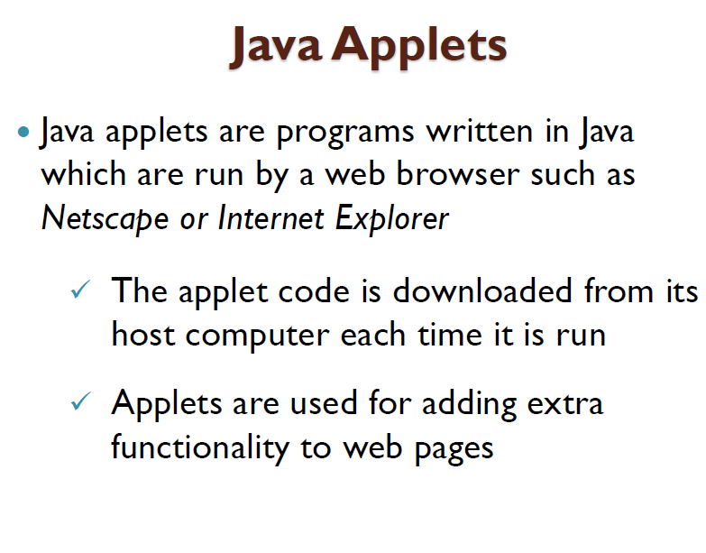

Slide 3
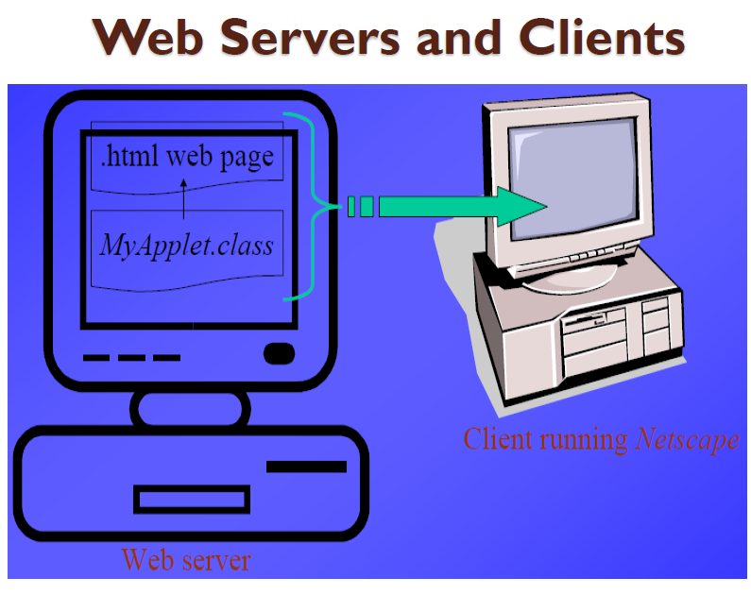

Slide 4
import java.awt.*;
import javax.swing.*;
public class App extends JApplet {
public void init() {
System.out.println("init");
}
public void start() {
System.out.println("start");
}
public void stop() {
System.out.println("stop");
}
public void destroy() {
System.out.println("destroy");
}

Slide 5
public void paint(Graphics g) {
super.paint(g);
g.drawString("inside Paint method", 100, 150);
}
}

Slide 6
The init() method is called once by a browser when the web page first creates the applet. The method usually contains code to perform basic setup tasks. If you do not provide this method in your applet then the method in JApplet is run.
The start() method is always called whenever the applet becomes visible.It is called immediately after the execution of init() on the first occasion, and then subsequently when the applet reappears after scrolling or browsing, for example.
The destroy() method is called by a browser at some convenient point when it decides to remove the resources of the applet. It thus allows the applet a last chance to clean up before it is removed.

Slide 7
This applet provides a paint() method that draws on its panel. This is called by the browser each time the panel's visible area is affected and is supplied with aGraphics object that facilitates drawing on its surface. Because paint() overrides the superclass method, a call of super.paint() is advisable since it ensures that any other components of the superclass are painted.
The three parameters of the call to drawString() are the text of the string, and the x and y coordinates of where the string is to be displayed.The x and y coordinates of where the string is to be displayed are actually the point of the baseline of the lefthand end of the string. Note that some characters, such as 'y', descend below the baseline.

Slide 8
<html>
<body>
<applet code="App.class" width=300 height=250>
</applet>
</body>
</html>

Slide 9
import java.awt.*;
import javax.swing.*;
public class App2 extends JApplet {
public void paint(Graphics g) {
super.paint(g);
g.drawString("ATI Naiwala,", 100, 150);
g.drawString("Sri Lanka ...", 100, 170);
g.drawLine(90, 135, 90, 180);
}
}

Slide 10
<html>
<body><center>
<applet code="App2.class" width=300 height=250>
</applet>
</body>
</html>

Slide 11
import java.awt.*;
import javax.swing.*;
public class App4 extends JApplet {
public void paint(Graphics g) {
super.paint(g);
int s=300;
int n=6; // n is number of divisions
int d=300/n; // size of each division
int i=1;
while (i<n) {
g.drawLine(0, d*i, s, d*i);
g.drawLine(d*i, 0, d*i, s);
i++;
}
}
}

Slide 12
import java.awt.*;
import javax.swing.*;
public class App5 extends JApplet {
public void paint(Graphics g) {
super.paint(g);
g.drawRect(50,100,75,120);
g.fillRect(150,75,100,175);
}
}

Slide 13
import java.awt.*;
import javax.swing.*;
public class App6 extends JApplet {
public void paint(Graphics g) {
super.paint(g);
Color c0=Color.pink,
c1=new Color(160,160,255);
g.setColor(c0);
g.fillRect(50,50,200,200);
g.setColor(c1);
g.fillRect(100,100,100,100);
}
}

Slide 14
import java.awt.*;
import javax.swing.*;
public class Histogram extends JApplet {
public void paint(Graphics g) {
super.paint(g);
int ai[] = {120, 30, 150, 70, 110, 10, 50};
for (int x=10, y=250,i=0; i < ai.length; ++i, x+=40) {
g.setColor(Color.yellow);
g.fillRect(x,y-ai[i],30,ai[i]);
g.setColor(Color.black);
g.drawRect(x,y-ai[i],30,ai[i]);
}
}
}

Slide 15
import java.awt.*;
import javax.swing.*;
public class App7 extends JApplet {
public void paint(Graphics g) {
super.paint(g);
g.setColor(Color.red);
int xa[] = {125,125,150,150,200,200};
int ya[] = {200,100,100,175,175,200};
g.fillPolygon(xa, ya, 6);
g.setColor(Color.black);
g.drawPolygon(xa, ya, 6);
int xa2[] = {100,100,225,225};
int ya2[] = {225,75,75,225};
g.drawPolygon(xa2, ya2, 4);
}
}

Slide 16
import java.awt.*;
import javax.swing.*;
public class App8 extends JApplet {
public void paint(Graphics g) {
super.paint(g);
int w = 200, h = w/2, s2 = 150;
g.setColor(Color.blue);
g.fillRect(s2-w/2,s2-h/2,w,h);
g.setColor(Color.yellow);
g.fillRect(s2-w/2,s2-h/6,w,h/3);
g.setColor(Color.black);
g.translate(s2-w/2,s2);
g.fillPolygon(new int[]{0,2*w/5,0},new int[]{h/2,0,-h/2},3);
}
}

Slide 17
import java.awt.*;
import javax.swing.*;
public class App9 extends JApplet {
String input;
public void init() {
input = JOptionPane.showInputDialog("Enter something here" );
}
public void paint(Graphics g) {
super.paint(g);
g.drawString("Your input is \""+input+"\"",50,150);
}
}

Slide 18
import java.awt.*; import javax.swing.*; import java.awt.event.*; public class Appq extends JApplet { JTextArea text = new JTextArea(); public void init() { JButton button = new JButton("Press Me"); button.addActionListener( new ActionListener() { public void actionPerformed( ActionEvent e ) { text.append("Button Pressed!\n"); } } ); Container cp = getContentPane(); cp.setLayout(new BorderLayout()); cp.add(button,BorderLayout.SOUTH); cp.add(text,BorderLayout.CENTER); String version = System.getProperty("java.version"); text.append("Java Version: " + version + "\n" ); } }

Slide 19
import java.awt.*;
import javax.swing.*;
import java.awt.event.*;
public class App10 extends JApplet implements ActionListener {
JTextArea text = new JTextArea();
public void init() {
JButton button = new JButton("Press Me");
button.addActionListener( this);
Container cp = getContentPane();
cp.setLayout(new BorderLayout());
cp.add(button,BorderLayout.SOUTH);
cp.add(text,BorderLayout.CENTER);
String version = System.getProperty("java.version");
text.append("Java Version: " + version + "\n" );
}
public void actionPerformed( ActionEvent e ) {
text.append("Button Pressed!\n");
}
}

